Slide 1

Dolphin Echolocation
Unveiling a powerful, nature-inspired approach to complex optimization problems, drawing insights from the ocean's most sophisticated hunters.
Ifraimova Maiia (БПИ228)

Slide 2
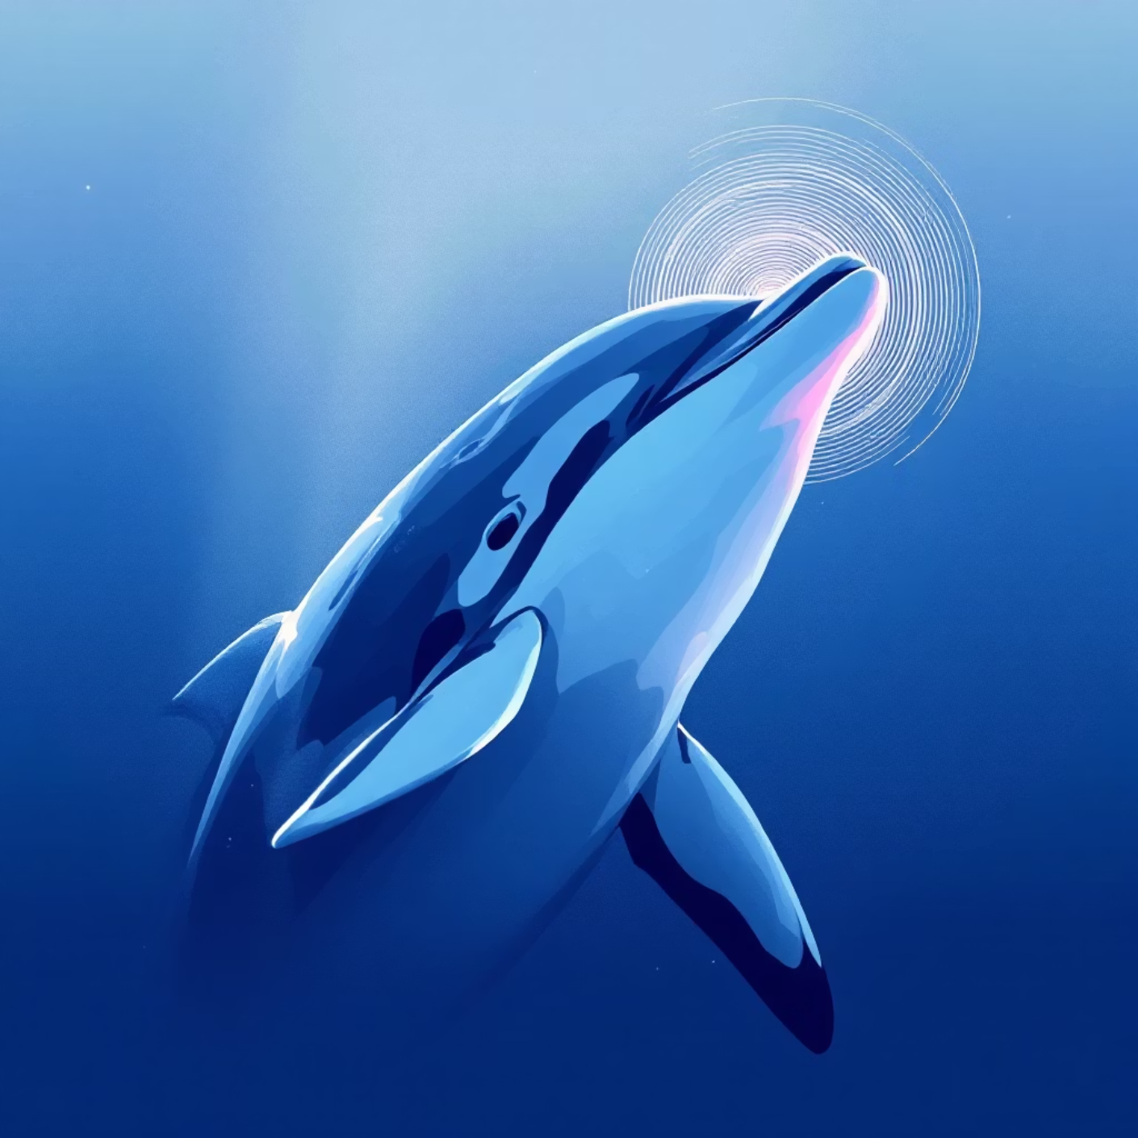
The Problem with Current Methods
Challenge in Meta-Heuristics
Algorithms like GA, PSO, ACO are powerful but have a major drawback: complex parameter tuning.
Engineers spend significant time adjusting these parameters for each problem.
We need an algorithm that is effective, efficient, and easy to control.
Inspiration from Nature
Dolphins are highly intelligent animals.
They use echolocation (biological sonar) to navigate and hunt.
Strategy: Emit clicks → listen for echoes → locate and track prey.
Core Idea: Mimic this efficient, adaptive search strategy to create a new optimization algorithm.

Slide 3


From Biology to Algorithm: The Core Analogy
Dolphin's Hunting Strategy
Optimization Algorithm
Global Search: Swim and explore the ocean.
Exploration: Randomly search the design space.
Target Detection: Receive an echo from prey.
Identify Solutions: Find promising fitness points.
Focused Search: Increase click rate near target.
Exploitation: Intensify search around best solutions.
Capture: Zero in on the precise location.
Convergence: Find optimal (or near-optimal) solution.
Key Insight: The Dolphin Echolocation (DE) algorithm naturally balances exploration and exploitation, adapting its search intensity to find optimal solutions efficiently.

Slide 4
The Heart of the Algorithm: Key Concepts
1
2
3
Convergence Factor (CF)
Accumulative Fitness (AF)
User-Driven Control
Measures how "concentrated" the search is on the best options, analogous to how dolphins focus their sonar pulses.
The main parameter is simply the Number of Loops.
Functions as a "sonar map" of the search space. Promising solutions emit a "fitness signal" that influences their neighbors.
You define the computational budget upfront.
CF = 0%: Pure random search (broad exploration).
Benefit: Predictable execution time and resource allocation, eliminating guesswork.
Good solutions add "fitness" to themselves and surrounding regions.
CF = 100%: All agents focused on the best solution (strong convergence).
Creates a probability landscape that guides the search toward high-potential areas.
The user defines the convergence curve, dictating how CF changes over iterations.

Slide 5
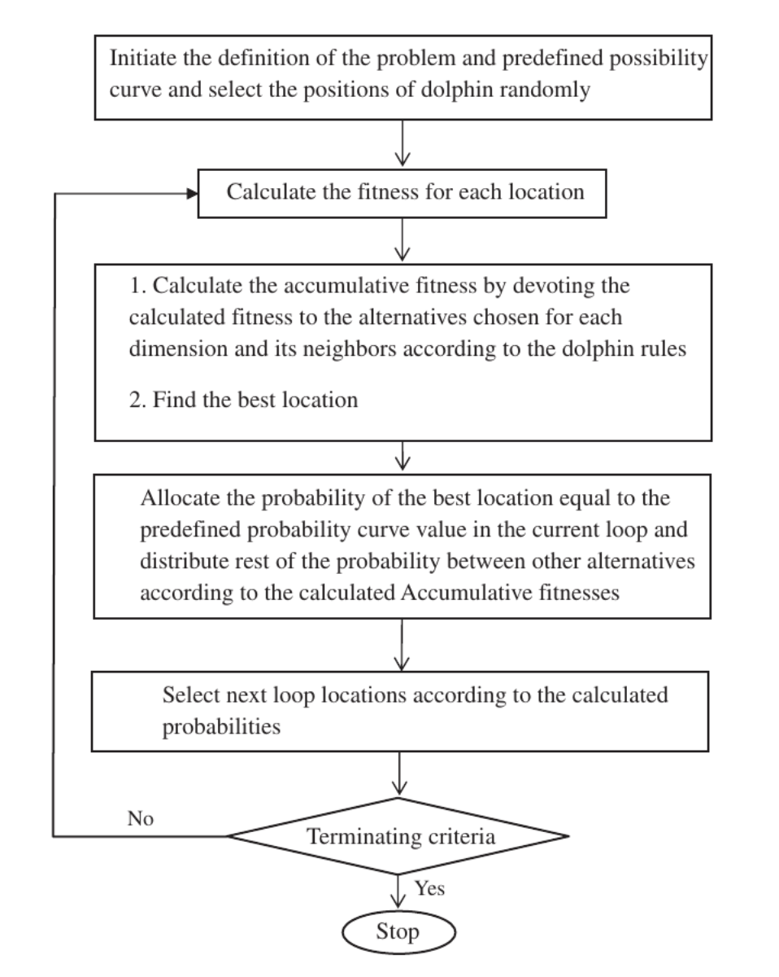
How It Works

Slide 6
Case Study 1: 25-Bar Spatial Truss Optimization
Goal:
Minimize the weight of a 25-bar spatial truss structure by selecting optimal cross-sections from a discrete set of available options.
Constraints:
The design must adhere to strict stress and displacement limits for structural integrity.
Result (Case 1):
Dolphin Echolocation (DE) Weight: 551.6 lb
Previous Best (HPSACO): 551.6 lb
Key Advantage: DE reached the same optimal weight in approximately 50 iterations, while the Hybrid Particle Swarm Optimization Ant Colony Optimization (HPSACO) algorithm required nearly 100 iterations.
Conclusion: Faster convergence to an equally high-quality solution, demonstrating superior efficiency.

Slide 7
Case Study 2: 72-Bar Spatial Truss Optimization
To further test the robustness of the Dolphin Echolocation algorithm, we applied it to a more complex structure: a 72-bar spatial truss with 16 distinct design variable groups.
The algorithm was tested under two different loading cases and with varying section lists, simulating real-world engineering challenges.
385.54 lb
391.33 lb
Case 1 Result
Case 2 Result
DE matched the best-known weight, confirming its ability to find established optimal solutions.
DE found a new, lighter design, outperforming traditional algorithms like GA and other meta-heuristics.
Conclusion: Dolphin Echolocation demonstrates reliable and robust performance, consistently delivering high-quality or superior designs across diverse and challenging problem setups.

Slide 8
Case Study 3: Large 582-Bar Tower Structure
To validate scalability, DE was applied to a real-world-scale problem: a 582-bar tower, featuring 32 design groups and 140 possible sections for each member. This structural optimization problem included strict constraints from the AISC steel design code.
Results (Case 2 - 50,000 evaluations):
Algorithm
Best Weight (lb)
vs. DE
Dolphin Echolocation (DE)
360,143
—
Artificial Bee Colony (ABC)
365,906
+1.6%
PSO (Literature)
363,796
+1.0%
Conclusion: Dolphin Echolocation achieves superior results (lower weight) on large, complex, and highly constrained problems, showcasing its exceptional performance in industrial-scale applications.

Slide 9





Performance Summary & Advantages
Few Parameters
Controlled Cost
Fast Convergence
Easy to set up and deploy; the primary focus is on the "Number of Loops" parameter.
Computational budget is defined upfront, providing predictable execution times.
Reaches high-quality solutions in fewer iterations compared to many alternatives.
High Accuracy
Versatile
Consistently finds optimal or significantly improved designs.
Effective on both discrete problems (e.g., section selection) and continuous optimization challenges.
Proven Against Other Algorithms
Dolphin Echolocation consistently outperformed or matched a wide array of established meta-heuristics in structural optimization benchmarks, including: GA, PSO, ACO, HS, SA, CSS, ICA, ABC, and many others.

Slide 10

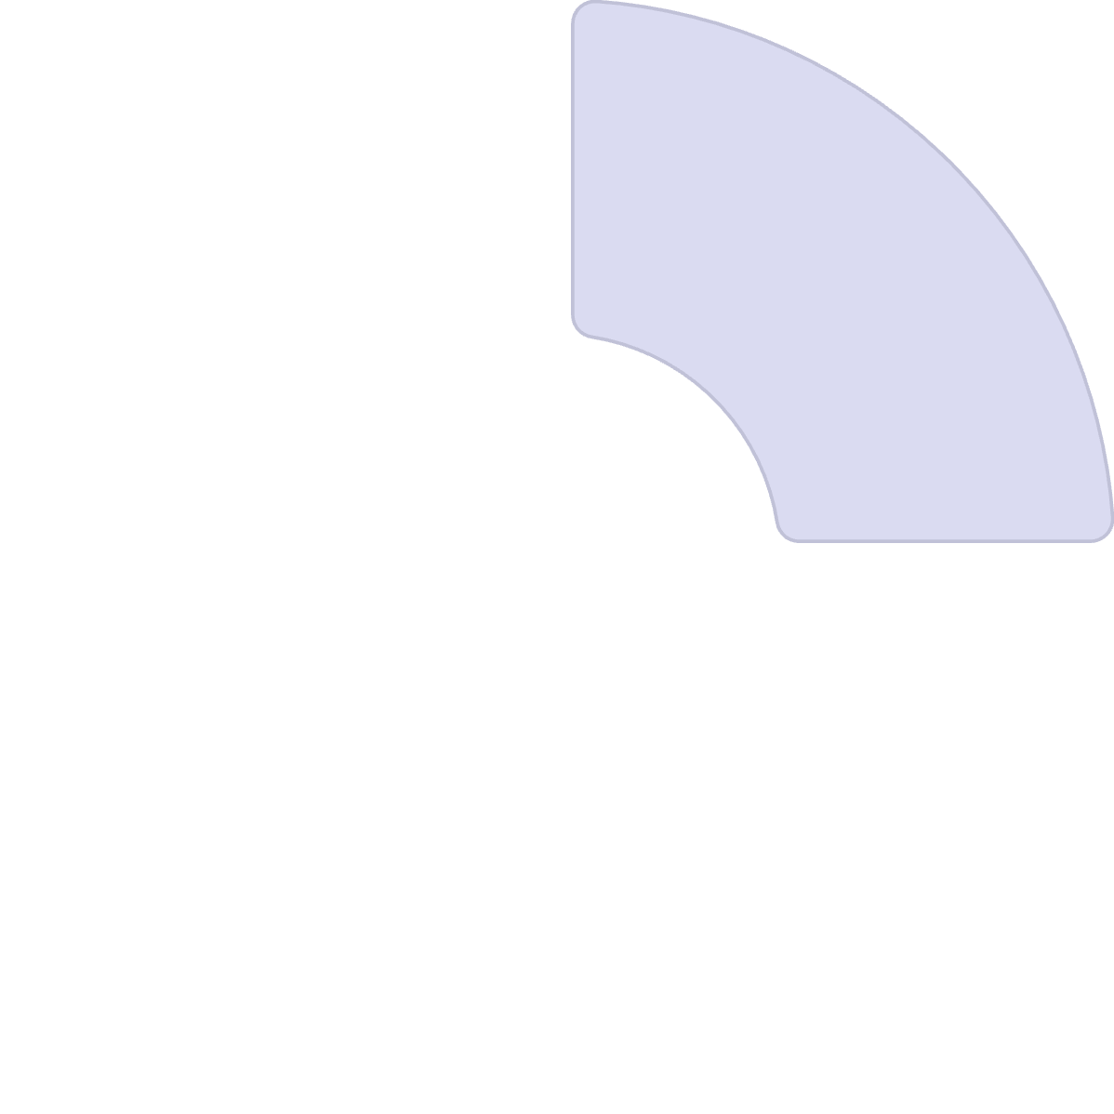






Final Takeaway & Future Vision
Novel Meta-Heuristic
Powerful & Practical
Dolphin Echolocation (DE) is a novel, nature-inspired meta-heuristic that translates the efficient hunting strategy of dolphins into a powerful global optimization algorithm.
Its user-controlled convergence factor and probabilistic "sonar map" make it both remarkably powerful and highly practical for diverse applications.
The Future of Biomimicry
Broader Impact
DE exemplifies the immense potential of biomimicry to develop advanced, robust, and intuitive computational tools for the challenges of tomorrow.
Beyond structural engineering, DE is applicable to any field with complex optimization problems, such as logistics, scheduling, machine learning, and financial modeling.

